Slide 1
Aspect Oriented Programming (AOP)
Tom Reddington
treddington@nyu.edu
Closures
Advice (lisp, Haskell)
Decorators(Python)
CS 6823 - Network Security
1

Slide 2
Advice
In aspect and functional programming, advice describes a class of functions which modify other functions when the latter are run; it is a certain function, method or procedure that is to be applied at a given join point of a program.
Advising consists of inserting new procedures at any or all of the entry or exit points to a particular procedure (or class of procedures). The procedures inserted are called "advice procedures" or simply "advice".
Since each piece of advice is itself a procedure, it has its own entries and exits. In particular, this means that the execution of advice can cause the procedure that it modifies to be bypassed completely, e.g., by specifying as an exit from the advice one of the exits from the original procedure; or the advice may change essential variables and continue with the computation so that the original procedure is executed, but with modified variables.
Advice Types – Before, After, Throws, Around

Slide 3
Python Memoize
The term "memoization" was introduced by Donald Michie in the year 1968. Memoisation is a technique used in computing to speed up programs. This is accomplished by memorizing the calculation results of processed input such as the results of function calls. If the same input or a function call with the same parameters is used, the previously stored results can be used again and unnecessary calculation are avoided.
Memoization can be explicitly programmed by the programmer, but some programming languages like Python provide mechanisms to automatically memoize

Slide 4
Memoize Fibonacci
def fib(n):
if n == 0:
return 0
elif n == 1:
return 1
else:
return fib(n-1) + fib(n-2)
Same values are calculated many times over.
i.e. Fib(100, 99, 98, 97, ...) all call fib(2)

Slide 5
Memoize Fibonacci
def memoize(f):
"single argument memoization for results of 'f'"
store = {}
def anon(x):
if store.has_key(x):
return store[x]
else:
y = f(x)
store[x] = y
print store
return y
return anon
fib = memoize(fib)
Calculation for a value are saved and not recomputed.
Store is closed over.

Slide 6
Fib(4) - store
fib(4)
{1: 1}
{0: 0, 1: 1}
{0: 0, 1: 1, 2: 1}
{0: 0, 1: 1, 2: 1, 3: 2}
{0: 0, 1: 1, 2: 1, 3: 2, 4: 3}

Slide 7
@memoize – Python Decorator type of advice
@memoize
def fib(n):
if n == 0:
return 0
elif n == 1:
return 1
else:
return (fib(n-1) + fib(n-2))

Slide 8
Fib(3)
fib(3)
{1: 1}
{0: 0, 1: 1}
{0: 0, 1: 1, 2: 1}
{0: 0, 1: 1, 2: 1, 3: 2}
2

Slide 9
Memoize Fibonacci
def memoize(f):
""" Memoization decorator for functions taking one or more arguments. """
class memodict(dict):
def __init__(self, f):
self.f = f
def __call__(self, *args):
return self[args]
def __missing__(self, key):
“””Method called when key is missing from Dictionary”””
ret = self[key] = self.f(*key)
“”” key is a tuple of the arguments, *key is the list of arguments
for foo(x,y) key is (x,y) *key is x,y ”””
return ret
return memodict(f)

Slide 10
Memoize two parameter functioh
@memoize
def foo(a, b):
return a * b
foo(2,3)
6
foo
{(2, 3): 6}
foo(3,4)
12
foo
{(3, 4): 12, (2, 3): 6}

Slide 11
Calling Functions And Variable Storage
What happens when main calls function f1? The run time system must:
Store where to return in main when f1 finishes executing
New memory needs to be allocated for
Variables declared locally in f1
Any parameters passed into f1
Activation Record stores this information

Slide 12

Storing Activation Records
Call sequence – main calls f1, f1 calls f2
Return sequence – f2 returns to f1, f1 returns to main
When executing in f2, only have access to the Activation Record of f2
When return from f2
Activation Record of f2 is not needed any more
Need the Activation Record of f1
//function prototypes not shown
int main ( ) {
f1 ( ); //call to function f1
//more code to execute …
}
void f1 ( ) {
f2 ( ); //call to function f2
//more code to execute
}
void f2 ( )
//some code to execute
}

Slide 13
Run Time Stack
Activation Records are stored on a Stack (called the Run Time Stack)
When a function is called
Push an Activation Record on the Run Time Stack
When return from a function
Pop off the top Activation Record
Go back to the calling function to the line of code that was stored within the Activation Record that was just popped off the Run Time Stack

Slide 14
Example
//note: This code doesn’t do any meaningful work
int main( ) {
int a = 5;
f1 ( a );
return 0;
}
void f1 (int n) {
int temp;
temp = n + 1;
f2 (temp);
return;
}
void f2 (int n) {
int temp;
temp = n * 5;
return;
}
Run Time Stack

Slide 15
Example
int main( ) {
int a = 5;
f1 ( a );
return 0;
}
void f1 (int n) {
int temp;
temp = n + 1;
f2 (temp);
return;
}
void f2 (int n) {
int temp;
temp = n * 5;
return;
}
a = 5 return to exit routine
AR of main
Run Time Stack

Slide 16
Example
int main( ) {
int a = 5;
f1 ( a );
return 0;
}
void f1 (int n) {
int temp;
temp = n + 1;
f2 (temp);
return;
}
void f2 (int n) {
int temp;
temp = n * 5;
return;
}
n = 5 return to line 3
temp = 6
AR of f1
a = 5 return to exit routine
AR of main
Run Time Stack

Slide 17
Example
int main( ) {
int a = 5;
f1 ( a );
return 0;
}
void f1 (int n) {
int temp;
temp = n + 1;
f2 (temp);
return;
}
void f2 (int n) {
int temp;
temp = n * 5;
return;
}
n = 6 return to line 9
temp = 30
AR of f2
n = 5 return to line 3
temp = 6
AR of f1
a = 5 return to exit routine
AR of main
Run Time Stack

Slide 18
Example
int main( ) {
int a = 5;
f1 ( a );
return 0;
}
void f1 (int n) {
int temp;
temp = n + 1;
f2 (temp);
return;
}
void f2 (int n) {
int temp;
temp = n * 5;
return;
}
n = 5 return to line 3
temp = 6
AR of f1
a = 5 return to exit routine
AR of main
Run Time Stack

Slide 19
Example
int main( ) {
int a = 5;
f1 ( a );
return 0;
}
void f1 (int n) {
int temp;
temp = n + 1;
f2 (temp);
return;
}
void f2 (int n) {
int temp;
temp = n * 5;
return;
}
a = 5 return to exit routine
AR of main
Run Time Stack

Slide 20
Example
int main( ) {
int a = 5;
f1 ( a );
return 0;
}
void f1 (int n) {
int temp;
temp = n + 1;
f2 (temp);
return;
}
void f2 (int n) {
int temp;
temp = n * 5;
return;
}
Run Time Stack

Slide 21

A Recursive Function
//note: This code doesn’t do any meaningful
//work
int main ( ) {
int a = 2;
f1 ( a );
}
void f1 (int n) {
if ( n == 0 ) //base case
return;
f1 ( n-1 ); //recursive call
}

Slide 22
A Recursive Function
int main ( ) {
int a = 2;
f1 ( a );
}
void f1 (int n) {
if ( n == 0 ) //base case
return;
f1 ( n-1 ); //recursive call
}
a = 2 return to exit routine
AR of main
Run Time Stack

Slide 23
A Recursive Function
int main ( ) {
int a = 2;
f1 ( a );
}
void f1 (int n) {
if ( n == 0 ) //base case
return;
f1 ( n-1 ); //recursive call
}
n = 2 return to line 3
AR of f1
a = 2 return to exit routine
AR of main
Run Time Stack

Slide 24
A Recursive Function
int main ( ) {
int a = 2;
f1 ( a );
}
void f1 (int n) {
if ( n == 0 ) //base case
return;
f1 ( n-1 ); //recursive call
}
n = 2 return to line 3
AR of f1
a = 2 return to exit routine
AR of main
Run Time Stack

Slide 25
A Recursive Function
int main ( ) {
int a = 2;
f1 ( a );
}
void f1 (int n) {
if ( n == 0 ) //base case
return;
f1 ( n-1 ); //recursive call
}
n = 1 return to line 8
AR of f11
n = 2 return to line 3
AR of f1
a = 2 return to exit routine
AR of main
Run Time Stack

Slide 26
A Recursive Function
int main ( ) {
int a = 2;
f1 ( a );
}
void f1 (int n) {
if ( n == 0 ) //base case
return;
f1 ( n-1 ); //recursive call
}
n = 1 return to line 8
AR of f11
n = 2 return to line 3
AR of f1
a = 2 return to exit routine
AR of main
Run Time Stack

Slide 27
A Recursive Function
int main ( ) {
int a = 2;
f1 ( a );
}
void f1 (int n) {
if ( n == 0 ) //base case
return;
f1 ( n-1 ); //recursive call
}
n = 0 return to = line 8
AR of f111
n = 1 return to = line 8
AR of f11
n = 2 return to = line 3
AR of f1
a = 2 return to =
exit routine
AR of main
Run Time Stack

Slide 28
A Recursive Function
int main ( ) {
int a = 2;
f1 ( a );
}
void f1 (int n) {
if ( n == 0 ) //base case
return;
f1 ( n-1 );
}
n = 1 return to = line 8
AR of f11
n = 2 return to = line 3
AR of f1
a = 2 return to =
exit routine
AR of main
Run Time Stack

Slide 29
A Recursive Function
int main ( ) {
int a = 2;
f1 ( a );
}
void f1 (int n) {
if ( n == 0 ) //base case
return;
f1 ( n-1 );
}
n = 2 return to = line 3
AR of f1
a = 2 return to =
exit routine
AR of main
Run Time Stack

Slide 30
A Recursive Function
int main ( ) {
int a = 2;
f1 ( a );
}
void f1 (int n) {
if ( n == 0 ) //base case
return;
f1 ( n-1 );
}
a = 2 return to =
exit routine
AR of main
Run Time Stack

Slide 31
A Recursive Function
int main ( ) {
int a = 2;
f1 ( a );
}
void f1 (int n) {
if ( n == 0 ) //base case
return;
f1 ( n-1 );
}
Run Time Stack

Slide 32
CLOSURES
A Programming Structure?
A function ?

Slide 33
CLOSURES
A closure is a function or reference to a function together with a referencing environment—a table storing a reference to each of the non-local variables of that function. A closure allows a function to access those non-local variables even when invoked outside of its immediate lexical scope.

Slide 34
SCHEME IMPLEMENTATION
CONTENT
Functions in function
Using outer symbols
Returning functions
Closures
Uses of Closures

Slide 35
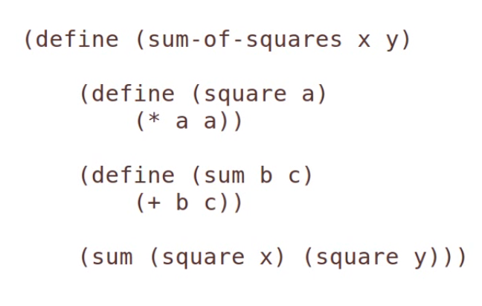
SCHEME IMPLEMENTATION
Functions in Function

Slide 36
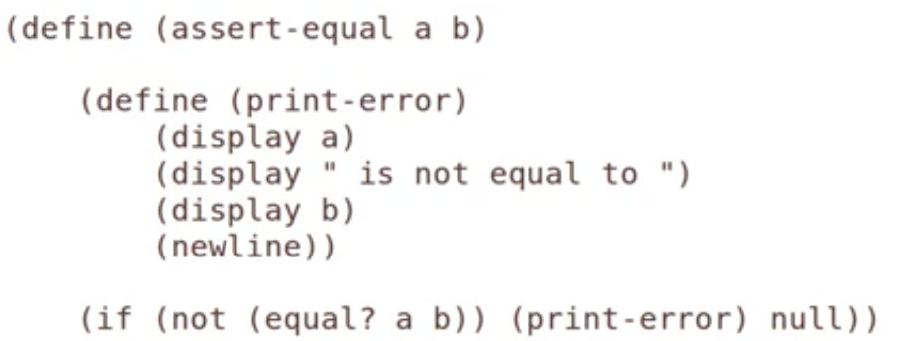
SCHEME IMPLEMENTATION
Using Outer Symbols

Slide 37
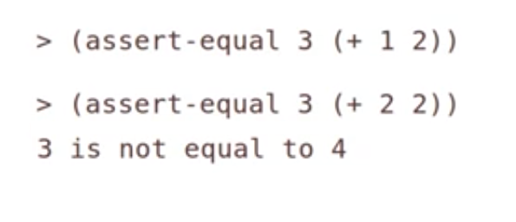
SCHEME IMPLEMENTATION
Even if display function is not taking any parameters it can access to the variables define outer function.
Using Outer Symbols

Slide 38
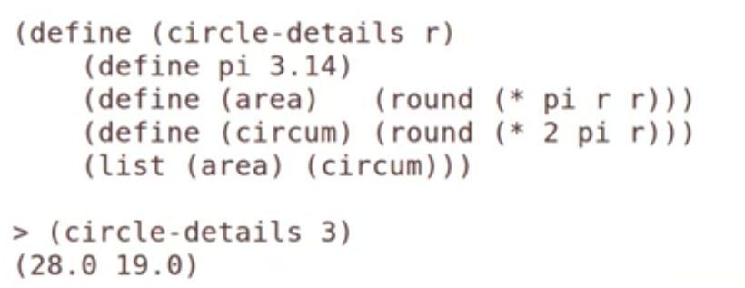
SCHEME IMPLEMENTATION
Using Outer Symbols(2)

Slide 39
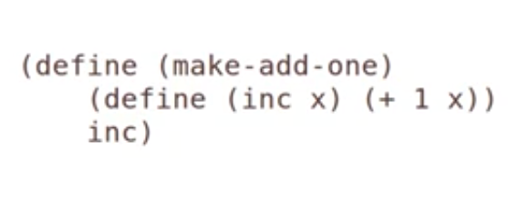
SCHEME IMPLEMENTATION
Returning Functions

Slide 40






SCHEME IMPLEMENTATION
Returning Functions

Slide 41
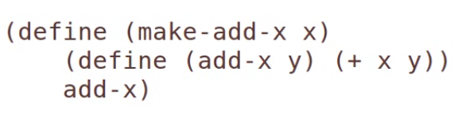



SCHEME IMPLEMENTATION
CLOSURES

Slide 42
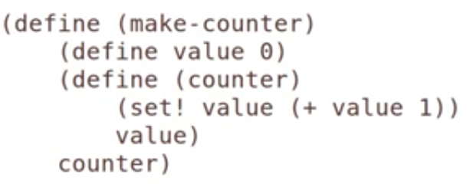
SCHEME IMPLEMENTATION
USES OF CLOSURES

Slide 43
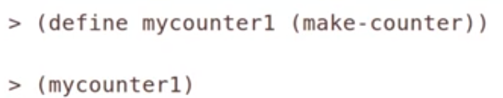



SCHEME IMPLEMENTATION
USES OF CLOSURES

Slide 44




SCHEME IMPLEMENTATION
USES OF CLOSURES

Slide 45
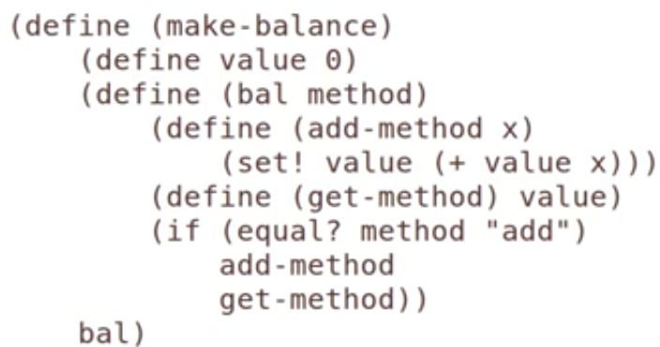
SCHEME IMPLEMENTATION
USES OF CLOSURES-TO CREATE A CLASS

Slide 46







SCHEME IMPLEMENTATION
USES OF CLOSURES-TO CREATE A CLASS

Slide 47




SCHEME IMPLEMENTATION
USES OF CLOSURES-TO CREATE A CLASS

Slide 48
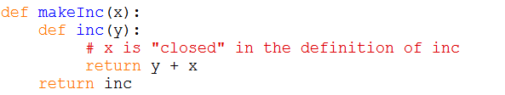
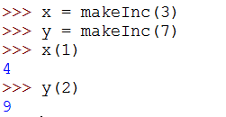
PYTHON IMPLEMENTATION
Closures in python are created by function calls. Here, the call to makeInc creates a binding for x that is referenced inside the function inc. Each call to makeInc creates a new instance of this function, but each instance has a link to a different binding of x.

Slide 49
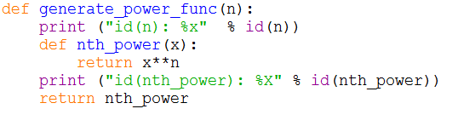
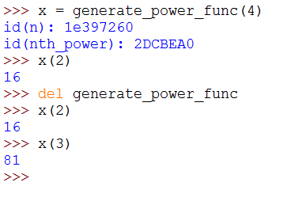
PYTHON IMPLEMENTATION

Slide 50
Python yield
def createGenerator():
myList=range(3)
for i in myList:
yield i*i
mygen=createGenerator()
for i in mygen:
print i
0
1
4

